Slide 1
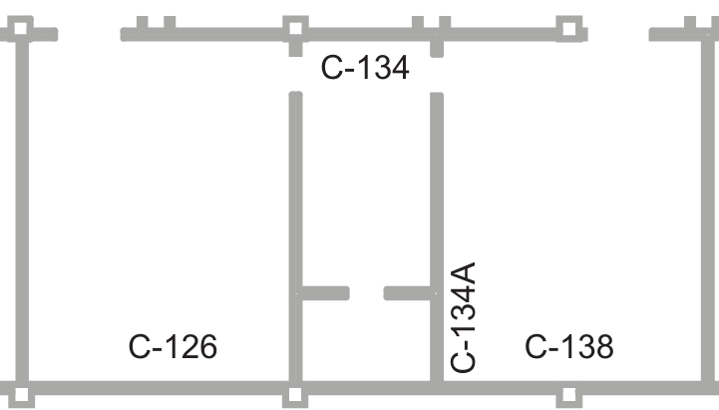

Slide 2
















Postings
Radiation Area Boundary
Material Safe
100 cm² Smears
1
2
3
4
5
6
7
8
9
10
11
12
13
14
15
16
17
18
19
20
21
22
23
24
Rad Waste
LSC Smears
1
2
3
4
5
6
7
8
µR/hr
Bricks / Shielding
mR/hr

